Slide 1

Communication Skills (SS-2010)
EE Spring 2025
Wk. 1.1
Jan. 20 – 24, 2025

Slide 2
Course Learning Objectives
Understanding Communication
Communication in Perspective (canned plans)
Verbal and Non-verbal Communication
Cross-cultural Communication
Barriers to Communication
Presentation Skills
Persuasive Communication
Group Communication
Conflict Management
Preparing for Job Interviews

Slide 3
Ch.1 Communication Perspectives (CLO-01,02)
Communication is a complex process through which we express, interpret, and coordinate messages with others.
We do so to create shared meaning, to meet social goals, to manage personal identity, and to carry out our relationships in informal conversation, group interaction, or public speaking.
Its essential elements are:
Participants (who)
Messages (what) (encoding/ decoding) (creating/ interpreting)
Context (where)
Channels (how)
Interference (distractions)
Feedback (reaction/ response)
Notes:
Up to this slide was covered in all 3 sections on Wk 1.1 * March, 21. For 1.2 on 10.3.21 all remaining slides to be done. Ask Qs at each slide to let SS participate and give their own examples.

Slide 4
Elements of Communication
Participants (who) – the individuals as senders and receivers in an interactive setting
Messages (the info) – verbal utterances/ visual images/ non-verbal behaviors to whom any meaning is attached/ associated, Encoding is creating, while decoding is interpreting the messages
Meanings (the intent) – thoughts/ ideas/ concepts/ intentions/ interpretations of others’ messages
Symbols (representations) – words, sounds, and actions that represent ideas/ concepts/ feelings
Encoding – the process of putting our thoughts and feelings into words and non-verbal cues
Decoding – the process of interpreting another’s message
Form – (Organization) the structure for better understanding

Slide 5
Week 1.2
Recap
What is ‘Communication’?
What are its elements?
What is ‘shared meaning’?

Slide 6
Canned Plans and Scripts
A canned plan is a ‘mental library’ of scripts of each of us draws from to create messages based on what worked for us or others in the past (Berger, 1997)
A script is an actual text of what to say and do in a specific situation
We have canned plans for a wide variety of social interactions (provide your examples)

Slide 7
Elements of Communication (Cont’d)
Context (the setting) – the parameters/ boundaries in which communication occurs
Physical – the physical parameters, surroundings, objects…
Social – the nature of relationships among participants
Historical – background and the chronological relations of info.
Psychological – mental processing, feelings, emotions, reactions
Cultural – values, beliefs, assumptions, rituals, norms, tradition, ethics

Slide 8
Elements of Communication (Cont’d)
Channels (the medium) – the parameters/ boundaries/ routes/ transportation modes in which communication occurs
Sensory – the five senses/ feelings/ emotions that communicate
Verbal – the use of language
Non-verbal – background and the chronological relations of info.
Visual – mental processing, feelings, emotions, reactions

Slide 9
Elements of Communication (Cont’d)
Interference (the distortion/ noise/ interruption) – any stimulus that hinders the process of sharing meaning; either physical or psychological
Physical – sights, sounds, any environmental stimuli that creates distraction from the intended meaning
Psychological – internal (mental) distractions based on feelings, emotions, preoccupations, assumptions, day dreaming, past experiences, semantic interpretations, symbolic references

Slide 10
Elements of Communication (Cont’d)
Feedback (the reaction/ response) – how the message is seen, heard, visualized, interpreted
Reaction – responding (emotionally or physically)to the message
Response – verbal feedback/ gestures/ sounds/ restatements/ appreciations

Slide 11
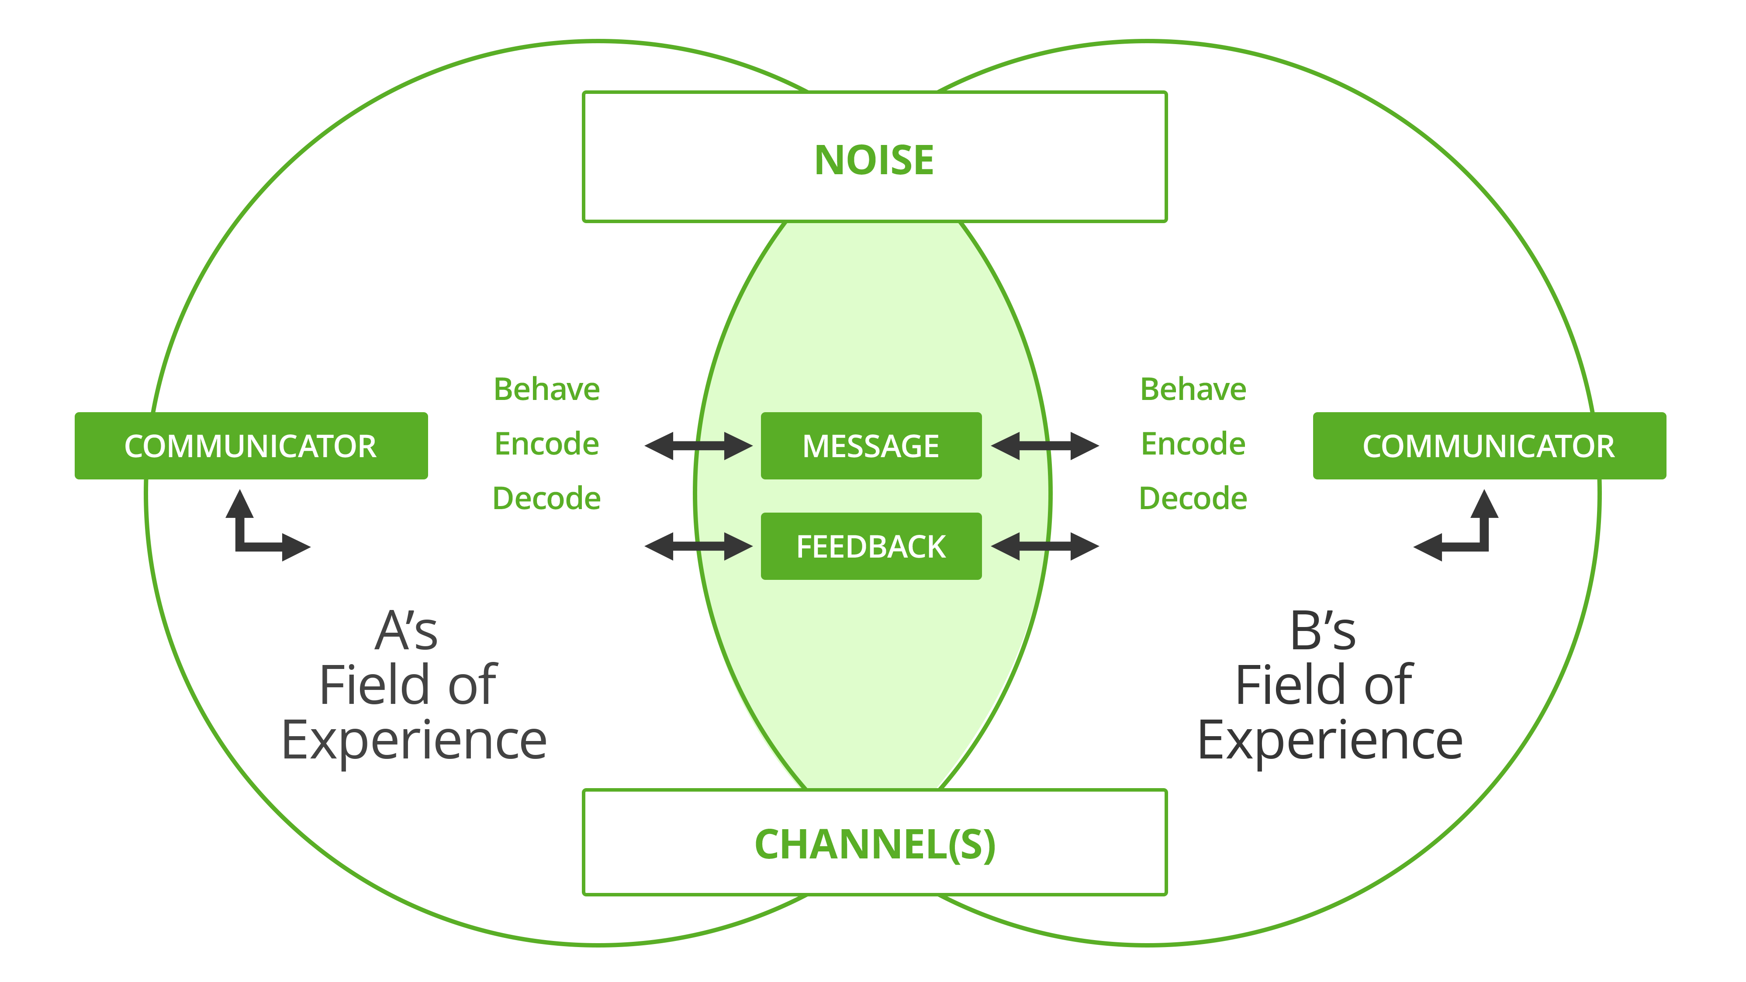
The Communication Model

Slide 12
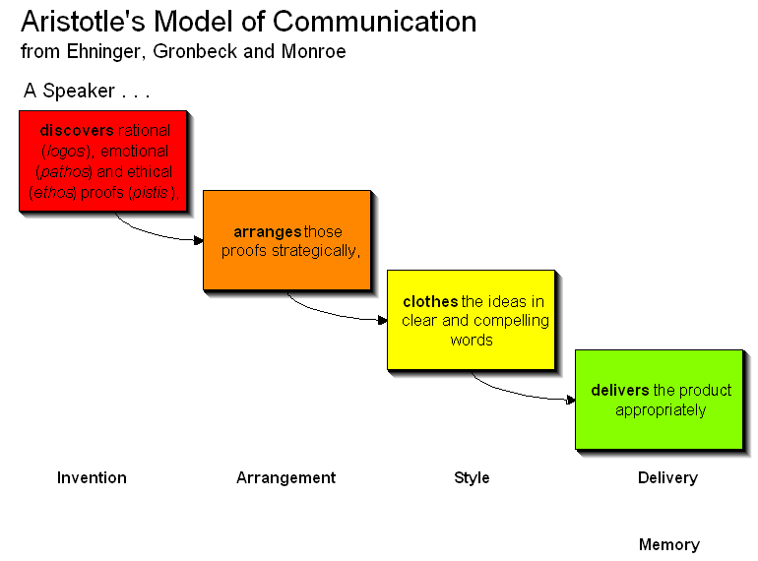

Slide 13
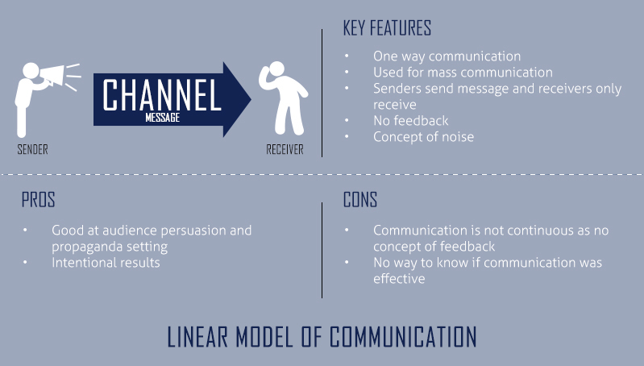

Slide 14
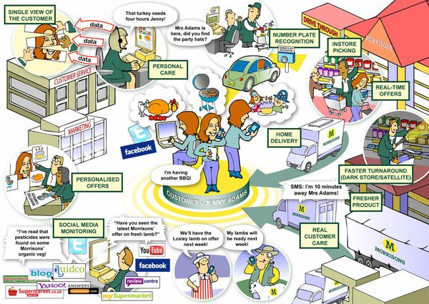
Healthcare Communication Model

Slide 15
Assigned Task – End of Week 1
Complete the reading of Ch.1.
You would have a pop-up quiz (10 points) (1% weightage) next week.
Make Groups of 4 students each.
Hand over the list to the Instructor in Excel sheet (will be posted shortly).

